Slide 1
Bisphosphonates 101: What you need to know and why
A presentation to the TOBA Board of Directors
April 5, 2019
Mary Scollay, DVM
Equine Medical Director
Kentucky Horse Racing Commission

Slide 2
A Brief Discussion on Bone Biology
Bone is a dynamic tissue.
Normal, healthy bones experience microfractures on a daily basis.
Those microfractures are addressed by two types of cells.
Osteoclasts—that clear away damaged bone
Osteoblasts—that build healthy, new bone
Failure of either of these cell lines, or an imbalance in their activity, can result in increased risk of fracture.

Slide 3
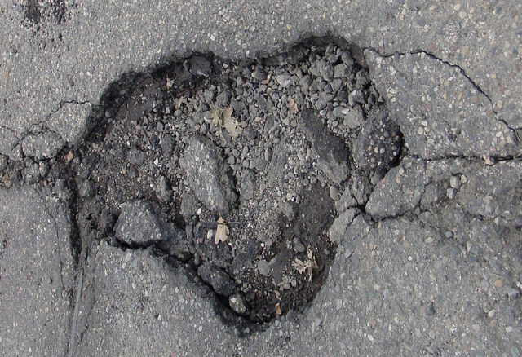
Bisphosphonates: What they do
BPs kill osteoclasts.
The result:
Damaged bone cannot be cleared away
New bone cannot be laid down to repair the defect
BPs have an analgesic effect.
The mechanism of action for this is not well characterized.

Slide 4
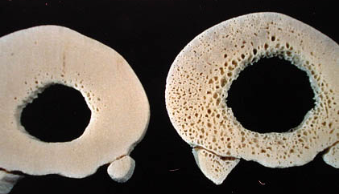
Bisphosphonates in Human Medicine
Used to prevent pathologic fractures in post-menopausal women with osteoporosis.
What? They’re used to prevent fractures in people but we’re worried that they cause fractures in race horses?
Normal Osteoporosis
The fracture risk in geriatric women is that osteoclast activity outpaces osteoblast activity. Destroying osteoclasts with BPs maintains a more dense, less fragile bone matrix—in the case of human geriatric patients, bad bone is better than no bone.

Slide 5
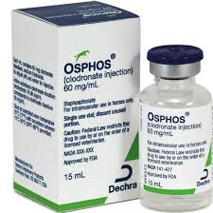
Bisphosphonates in Equine Medicine
Two products, Tildren and OsPhos, have FDA approval for use in the horse.
The labelled indication is for the treatment of navicular disease in horses 4 years of age and older.
Analgesia is the intended effect. (Improved lameness score.)

Slide 6
Off-Label/Extra-label Use of FDA-approved medications
Veterinarians have the legal authority for ‘off/extra-label’ use—the administration of a medication at alternative doses, by alternative routes, at different intervals, and for treatment of conditions other than those described on the label.
Examples:
Gentocin has FDA approval for intrauterine use only, yet it is commonly administered intravenously or intramuscularly to treat systemic disease.
The labelled dose for procaine penicillin is 3,000 IU per pound (10 ml for a 1,000 lb horse) but most veterinarians use a much higher dose.

Slide 7
Off-label use of BPs
Reports of BP administration of to young horses in sales
prep to diminish radiographic evidence of sesamoiditis
thus improving their commercial value.
Defects (channels) in sesamoid bones are the result of osteoclast activity.
If osteoclast activity is interrupted, the channels don’t develop. At least that’s the idea behind the use of BPs in horses of this age.
If the images are improved does that mean that the horse doesn’t have sesamoiditis?
BPs do not treat sesamoiditis. Their use is intended to obscure evidence
of its presence. This is NOT a legitimate therapeutic use of the medication.

Slide 8
Bisphosphonates: The implications of halting osteoclast activity in the young racehorse in training?
Horses’ bones MUST remodel and adapt to high speed exercise or they will fail.
Bones adapt most effectively and efficiently in 2-3 year olds.
If bone is not ‘trained’ during this critical period, the horse is at significantly increased risk of fatal fracture for its entire racing career. This is why, almost counterintuitively, it is much safer for a horse to race as a 2 year old than to wait to ‘let him grow up’ and initiate training later—when his bones can no longer adequately adapt to the work of racing.
Bisphosphonates administered to 2 year olds in sales prep will exert their effect on osteoclasts—halting bone adaptation--during the critical remodeling period.

Slide 9
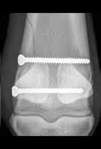
Bisphosphonates and bone healing
A number of equine surgeons have remarked that fracture healing following surgical repair is substantially delayed in horses known to have been treated with bisphosphonates.
At a recent meeting, surgeons discussed their personal observations with respect to the duration of effect, and were in agreement that radiographic findings don’t normalize until about 8 months post-treatment.

Slide 10
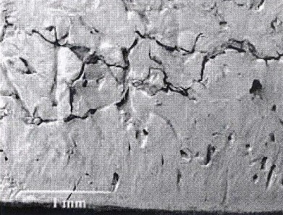
Palmar osteochondral disease, non-adaptive bone disease, or bone bruising are all terms used to describe bone remodeling (osteoclast/osteoblast activity) that cannot keep up with the forces acquired through high speed exercise.
Appropriately diagnosed, and given rest and time, the osteoclasts and osteoblasts catch up; the bone is strengthened, and training can resume.
The conventional layoff for this condition may be inadequate when BPs are present.
With continued, or resumed, high-speed exercise microfractures will continue to develop.
When BPs interrupt the osteoclast/osteoblast cycle, these microfractures can coalesce into major fault lines in the bone—and result in bone failure.

Slide 11
The really tricky part?
That BP-treated horse may change hands multiple times before it gets to the trainer at the racetrack, and that trainer can’t possibly know that the horse was treated with BPs.
So there is no opportunity to modify the horse’s management in consideration of an impaired ability for its bones to appropriately respond to training.

Slide 12
The Use of Bisphophonates in Racing Horses < 4 yo
Evidence that BPs are also being administered for their analgesic effect to horses in training and racing.
There are more effective and more affordable analgesics available.
Why use BPs?
Evading detection by drug testing?
A belief that they are more effective for ‘bone pain’?
And if that ‘bone pain’ is a consequence of non-adaptive bone disease, does treatment with BPs represent the ‘perfect storm’?

Slide 13
Bisphosphonates in horses: There’s a lot we don’t know
Is there a cause and effect relationship between bisphosphonates and fracture?
How long before osteoclast/osteoblast activity returns to normal after a horse is treated with bisphosphonates?
Are there biologic markers that indicate bisphosphonates are having an effect on a horse’s bone?
What is the best way to manage the training of a young horse that has been treated with bisphosphonates?
How long is the period of analgesia?

Slide 14
Bisphosphonates: The regulatory challenge?
Testing methods are inadequate.
The window of detection does not correlate to the duration of the drug’s effect.
The current testing method is a special separate test. It is neither practical nor affordable to routinely test for BPs.
It is difficult to access young horses during the interval when BP treatment would be expected to occur.
Testing at the wrong time can result in a false sense of security.

Slide 15
Bisphosphonates: The challenge
Effective regulation will require a collaborative effort by all stakeholders: breeders, sales companies, trainers, veterinarians, racing associations, and racing authorities.
One sector acting alone cannot establish meaningful protections for the horse.

Slide 16
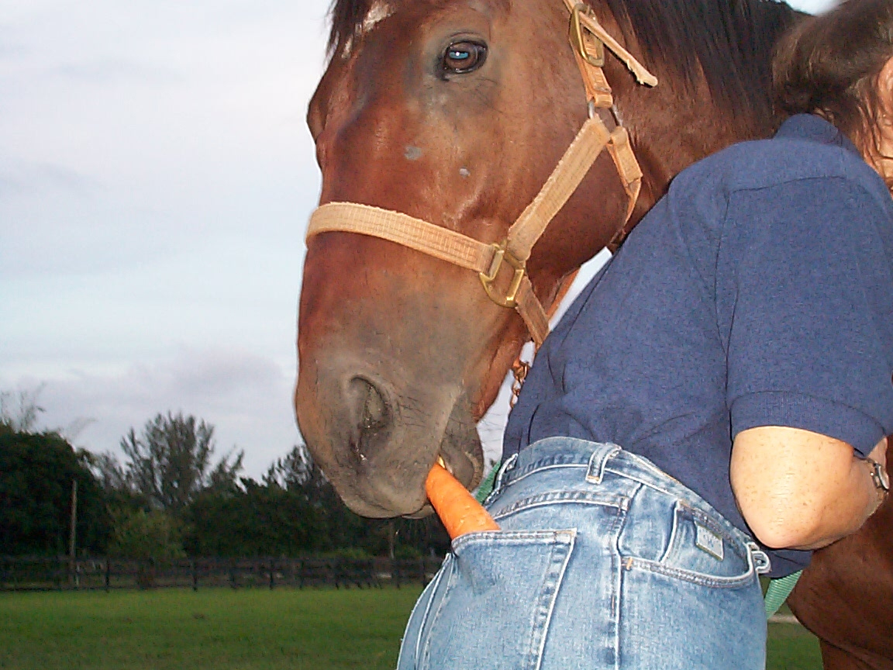
Office: (859) 246-2040
Mobile: (859) 489-7677
Mary.Scollay@ky.gov
Thank you!

